Slide 1
Medodyne
CE-097.Khushal Pujara
CE-102.Rajyaguru Keval
CE-107.Rathod Bhargav
HOSPITAL MANAGEMENT SYSTEM SOFTWARE

Slide 2
User Functionalities
Register user and login to see user’s homepage.
Sub functionalities: Forgot Password , Remember me next time using cookies
Find Doctors as per Name , Specialist , Category or Doctor Degree & check details of doctors like availability , email , contact number etc.
Create user’s future appointment with appropriate doctor & date.
Pending appointments also can be cancelled. Confirmed appointments cannot be cancelled.
Check all hospital room details : Room type , availability , and current admitted patient’s details.
Create or update user’s profile.
Shop medicines
Sub functionalities : Place order , Add to cart , Auto complete extender for medicine name
Feedback submission

Slide 3
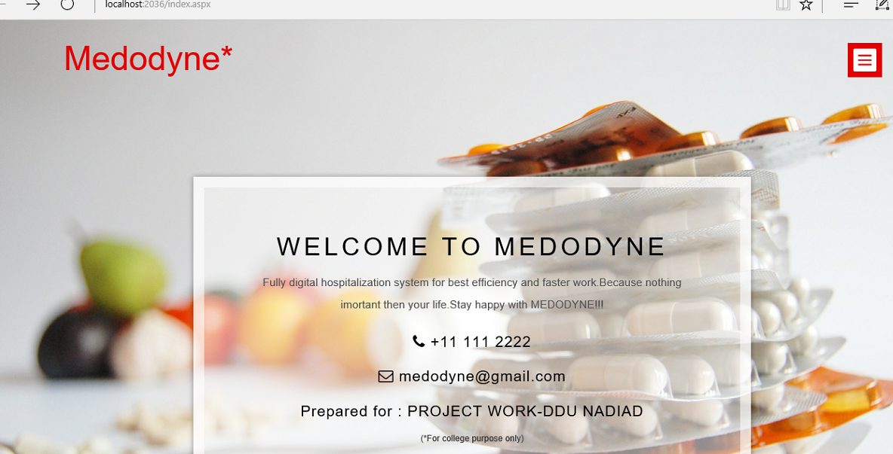

Slide 4
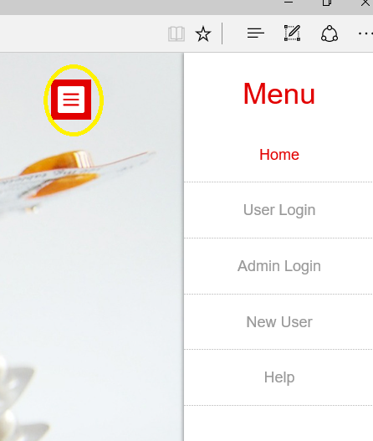
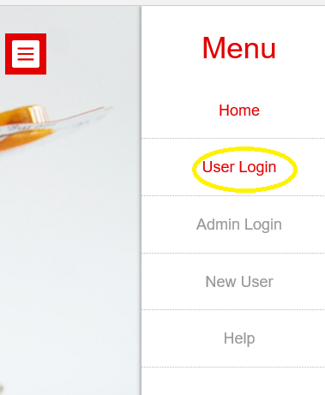

Slide 5
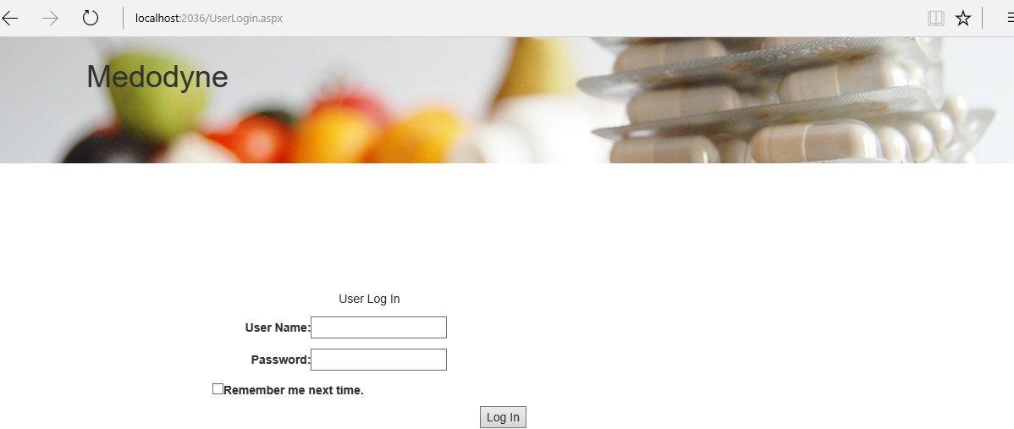
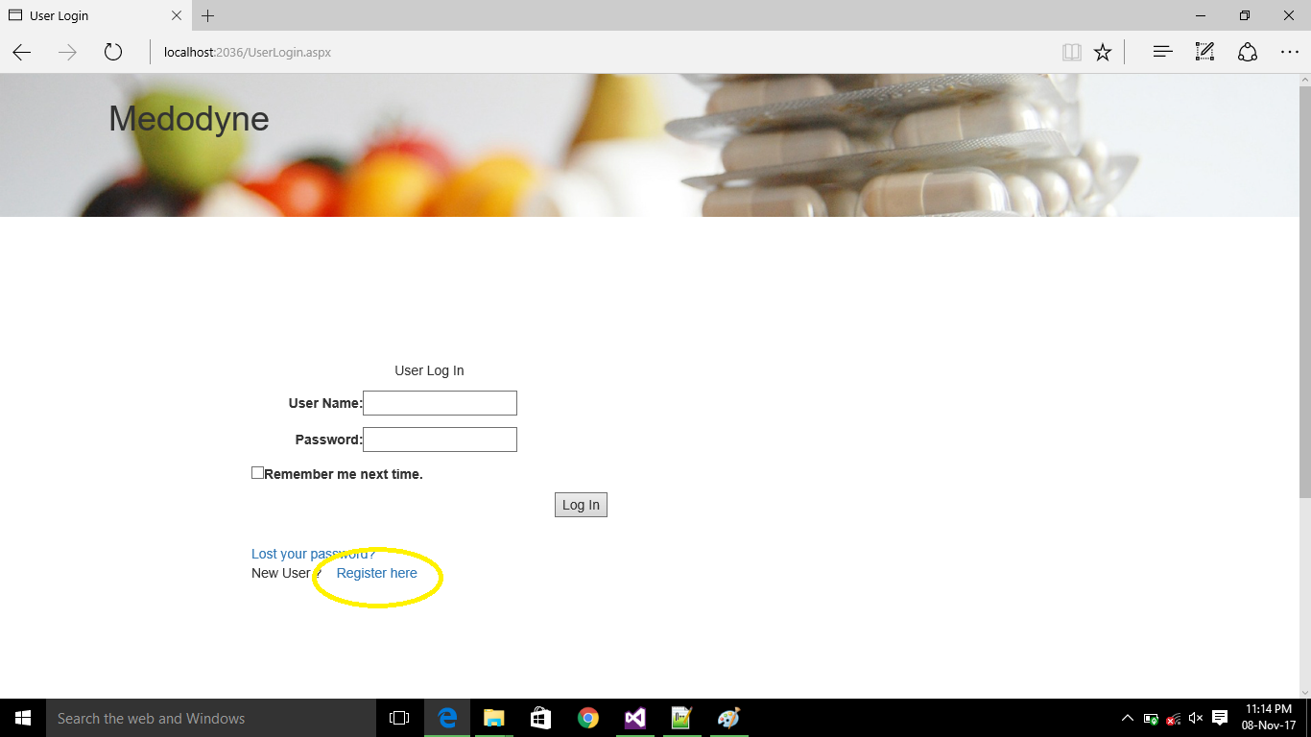

Slide 6
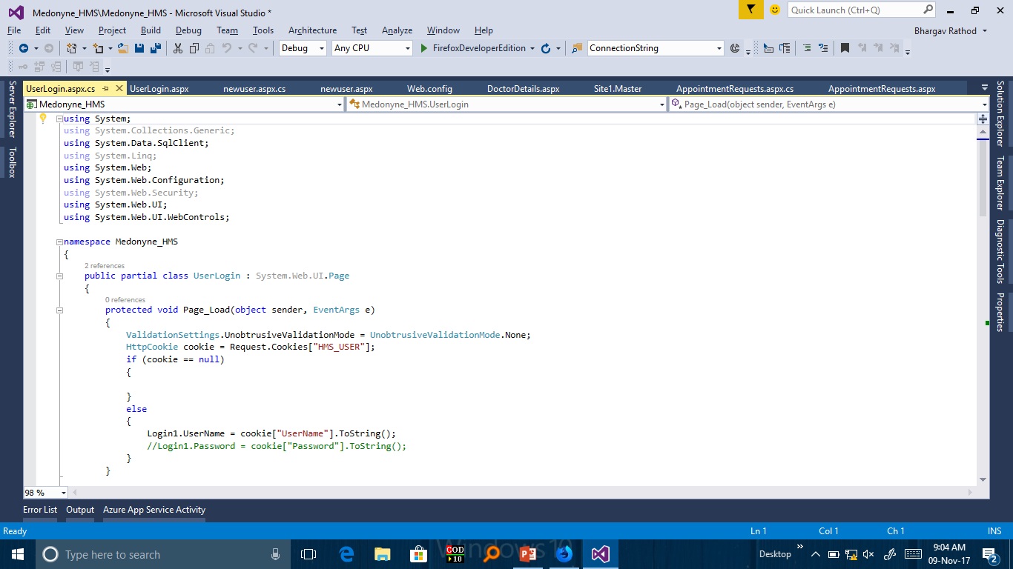

Slide 7
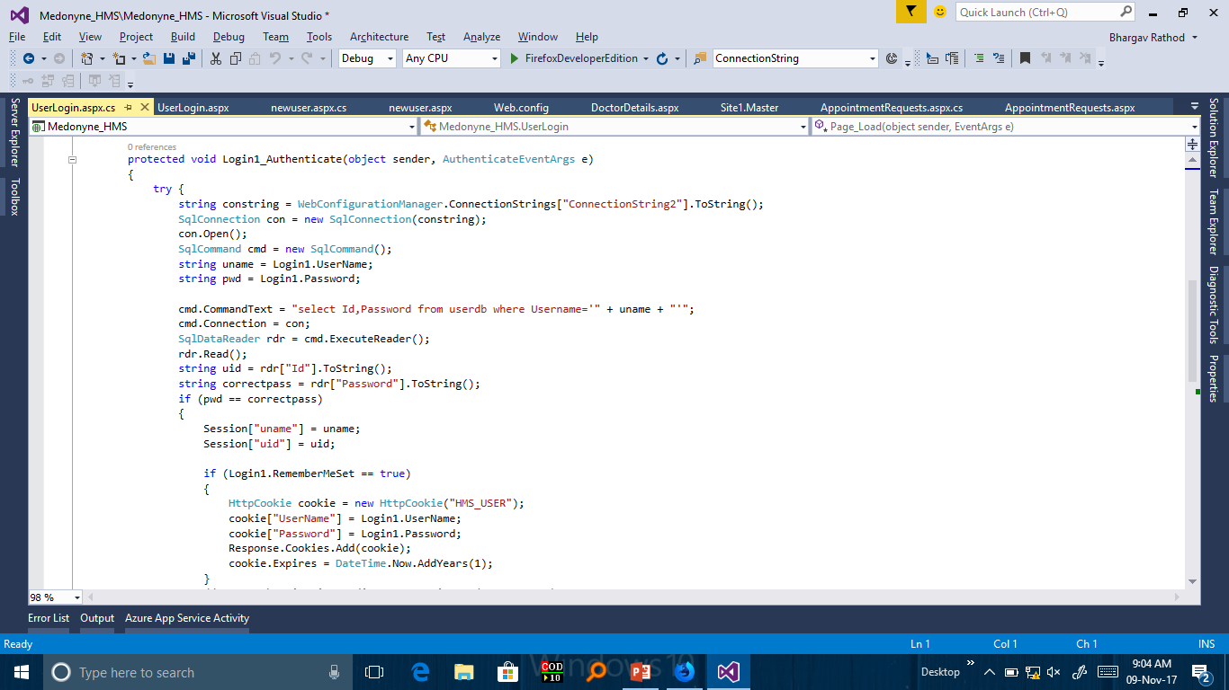

Slide 8
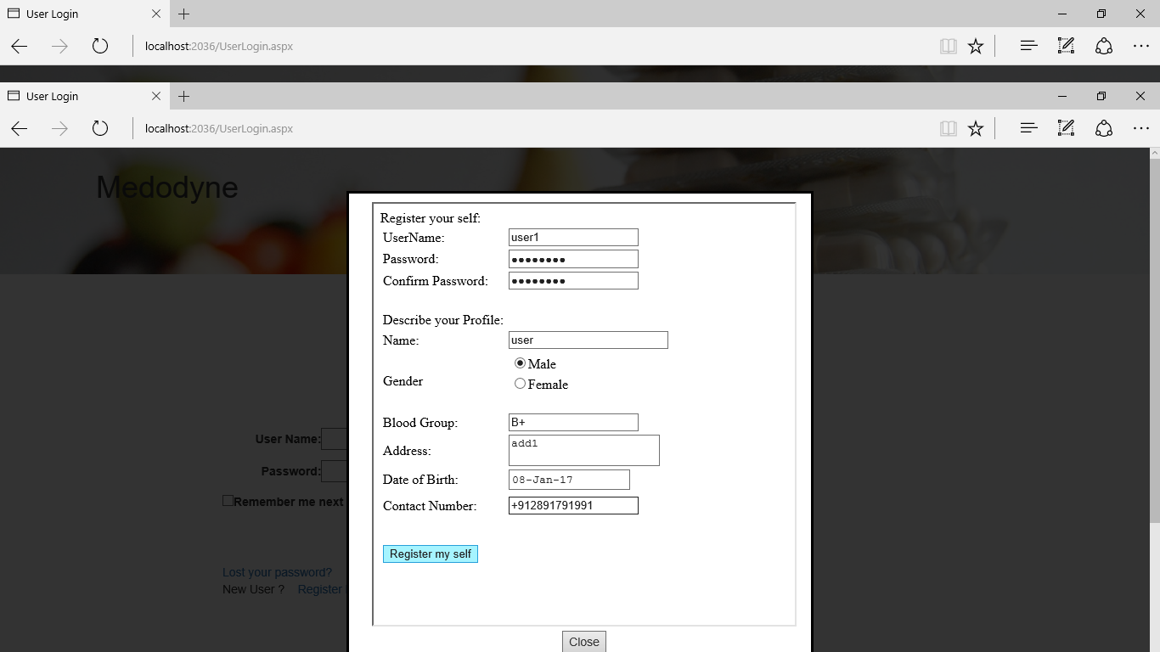

Slide 9
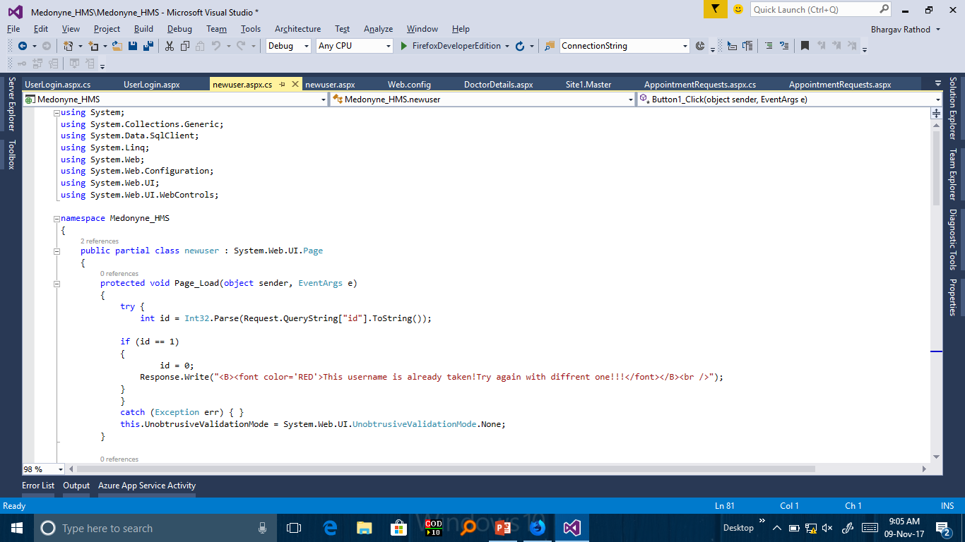

Slide 10
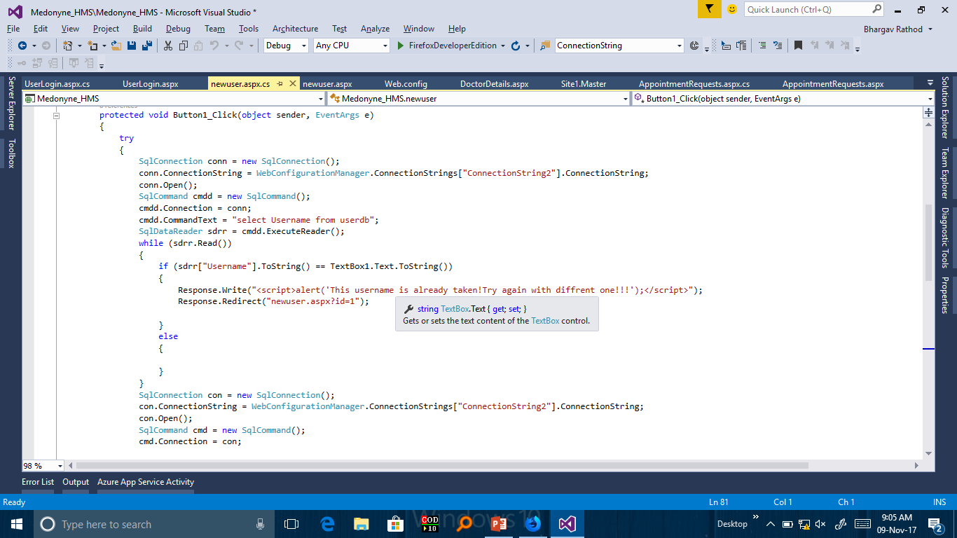

Slide 11
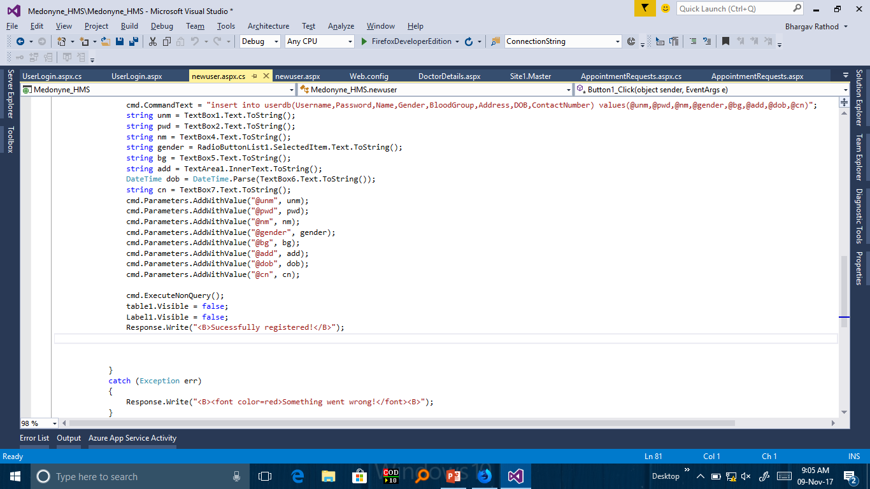

Slide 12
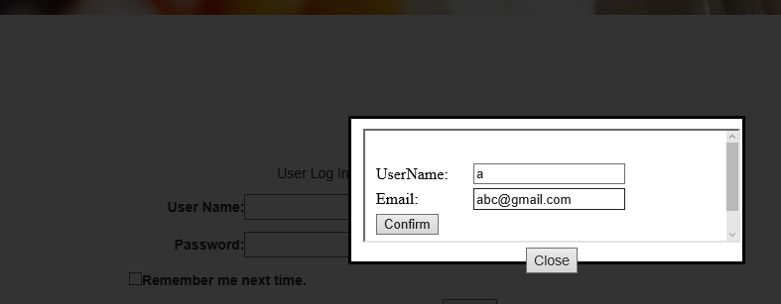

Slide 13
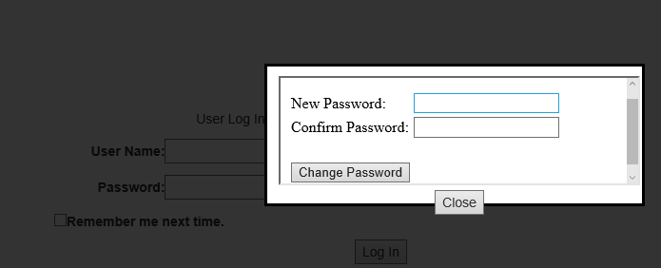

Slide 14
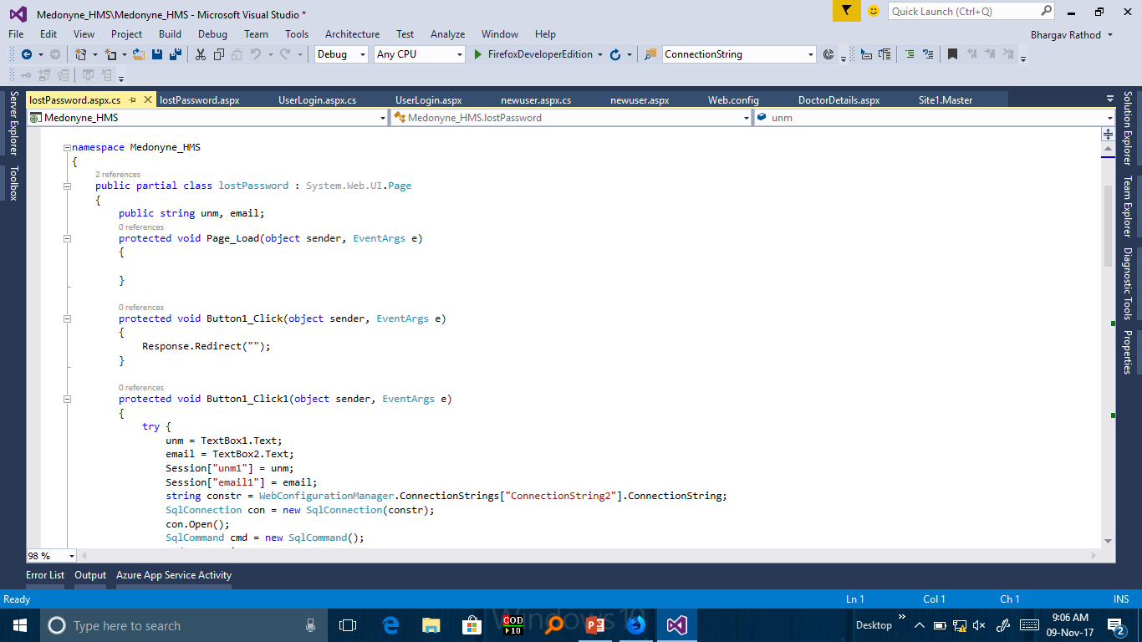

Slide 15
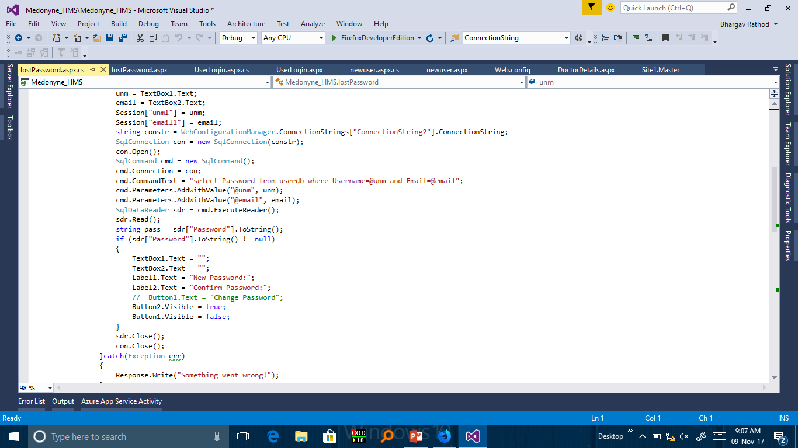

Slide 16
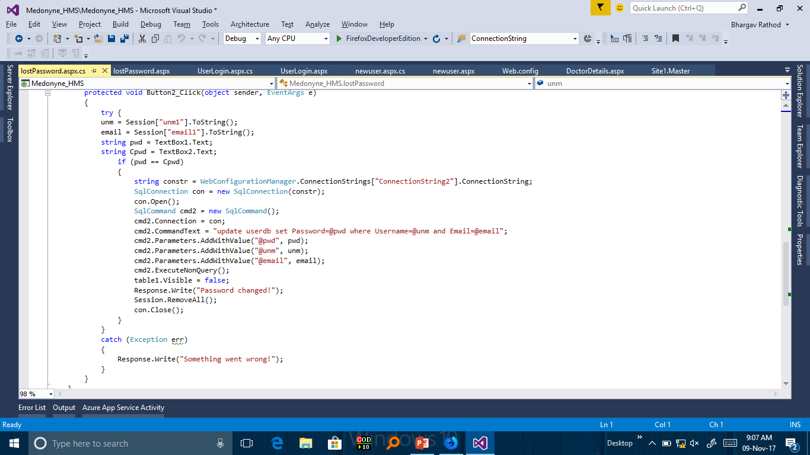

Slide 17
1.index.aspx→For Home Page and for menuItems by ModelPopupExtender
2.Userlogin.aspx →For Login User
3.lostPassword.aspx→For Lost Password and Reset Password
4.Newuser.aspx → To register New User

Slide 18
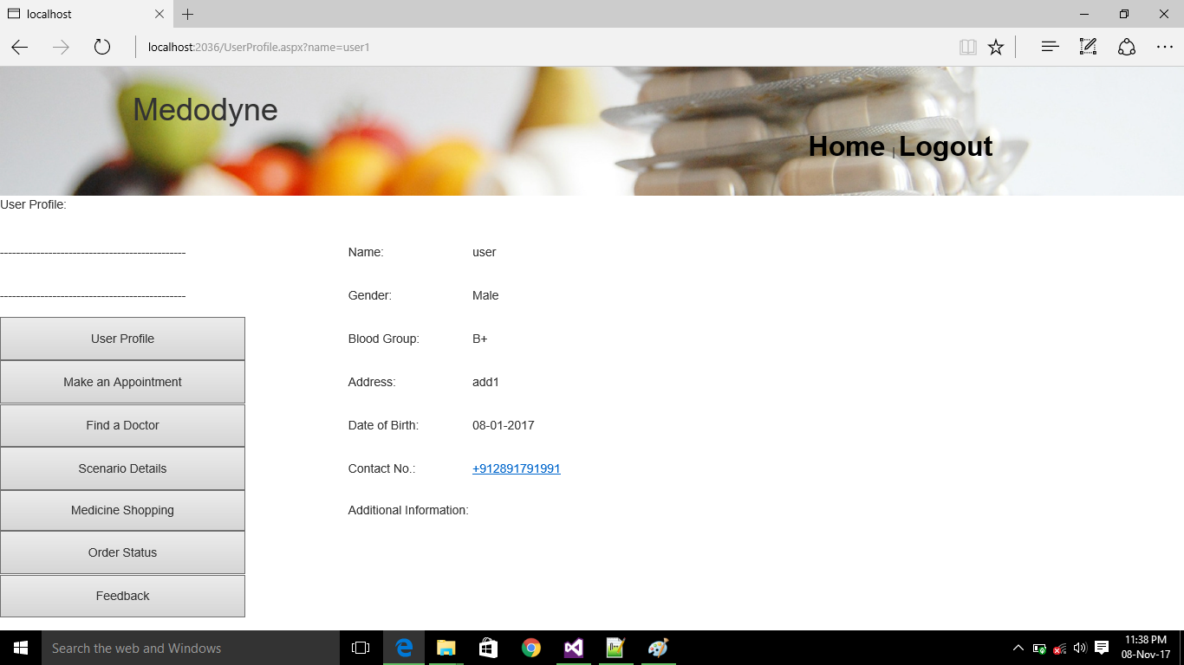
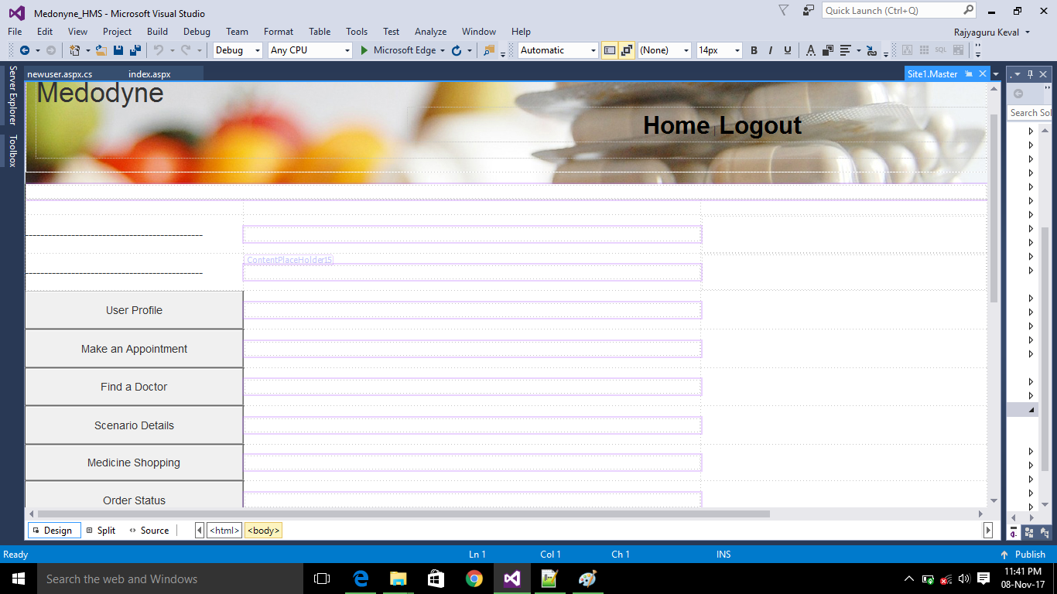

Slide 20
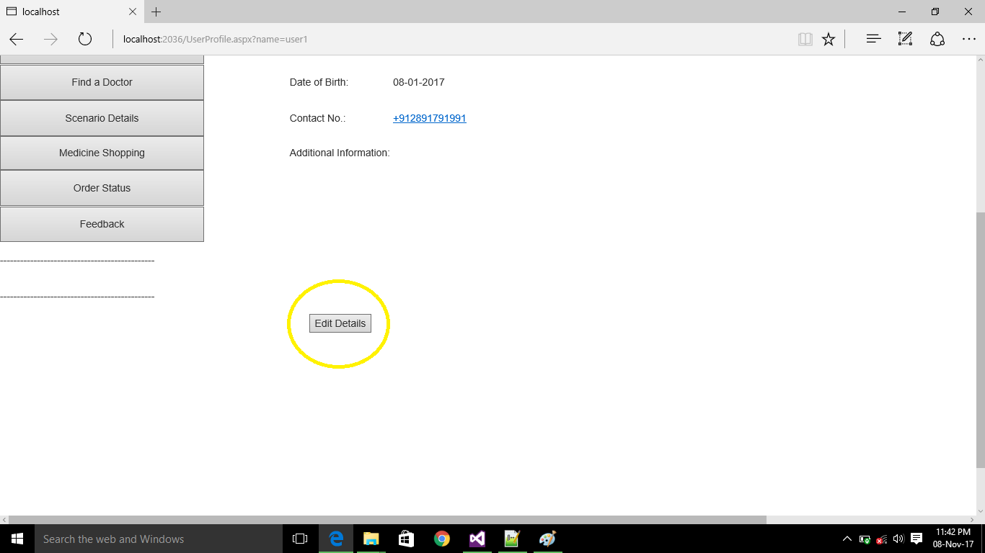

Slide 21
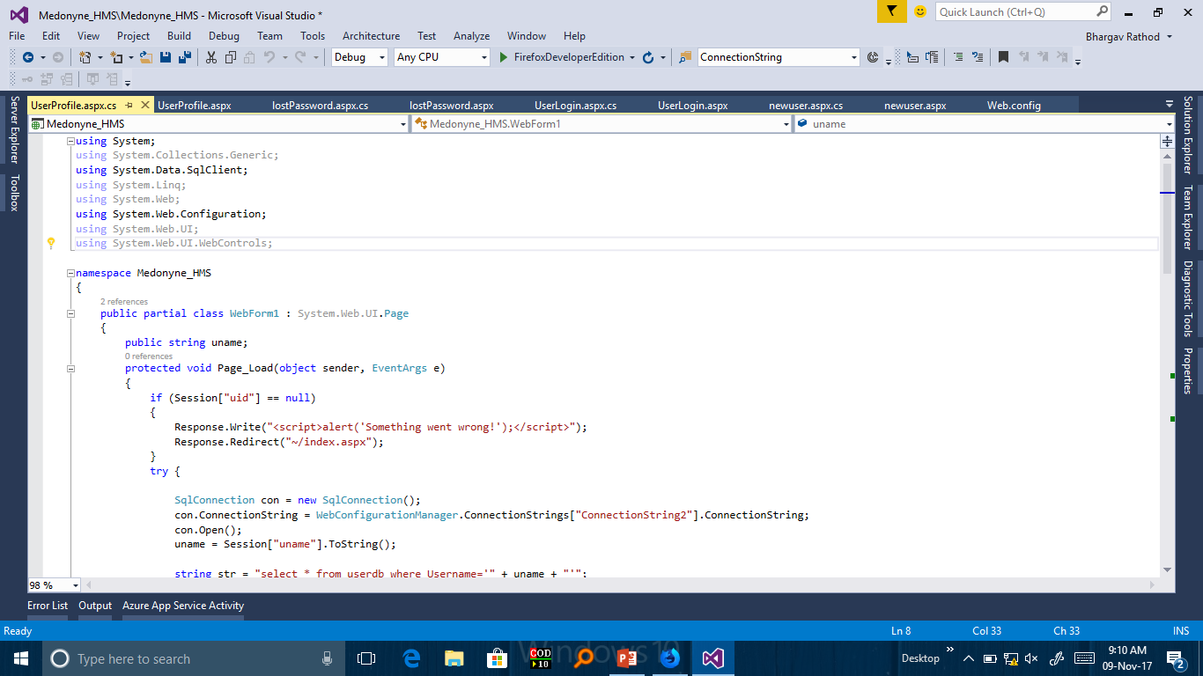

Slide 22
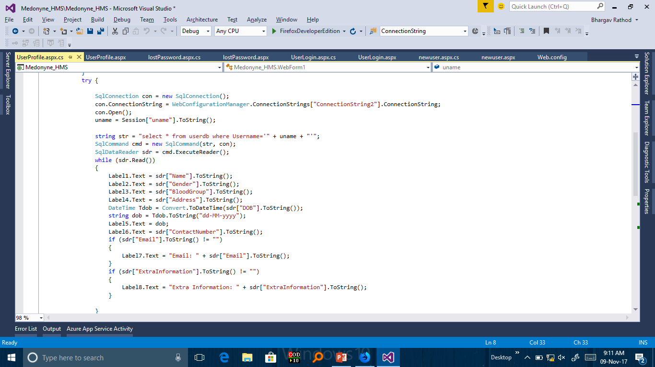

Slide 23
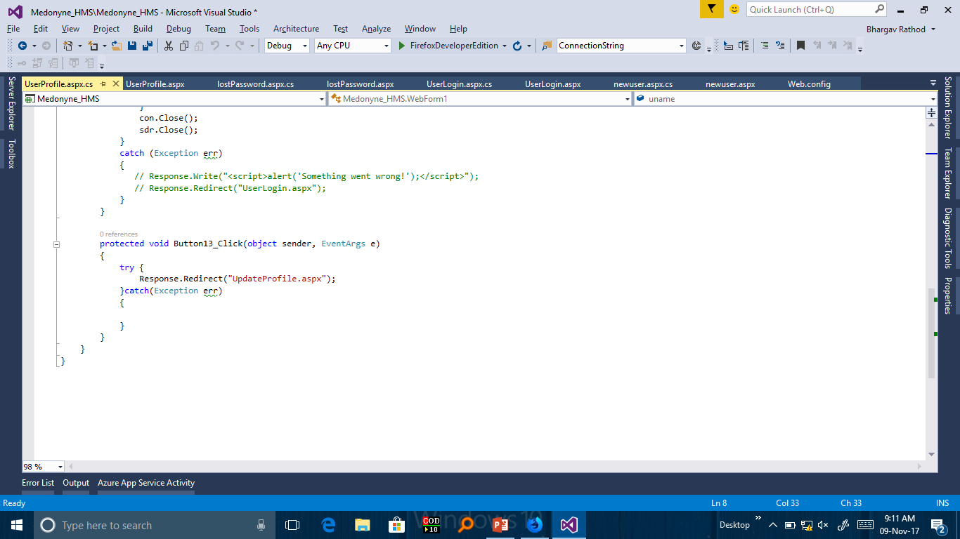

Slide 24
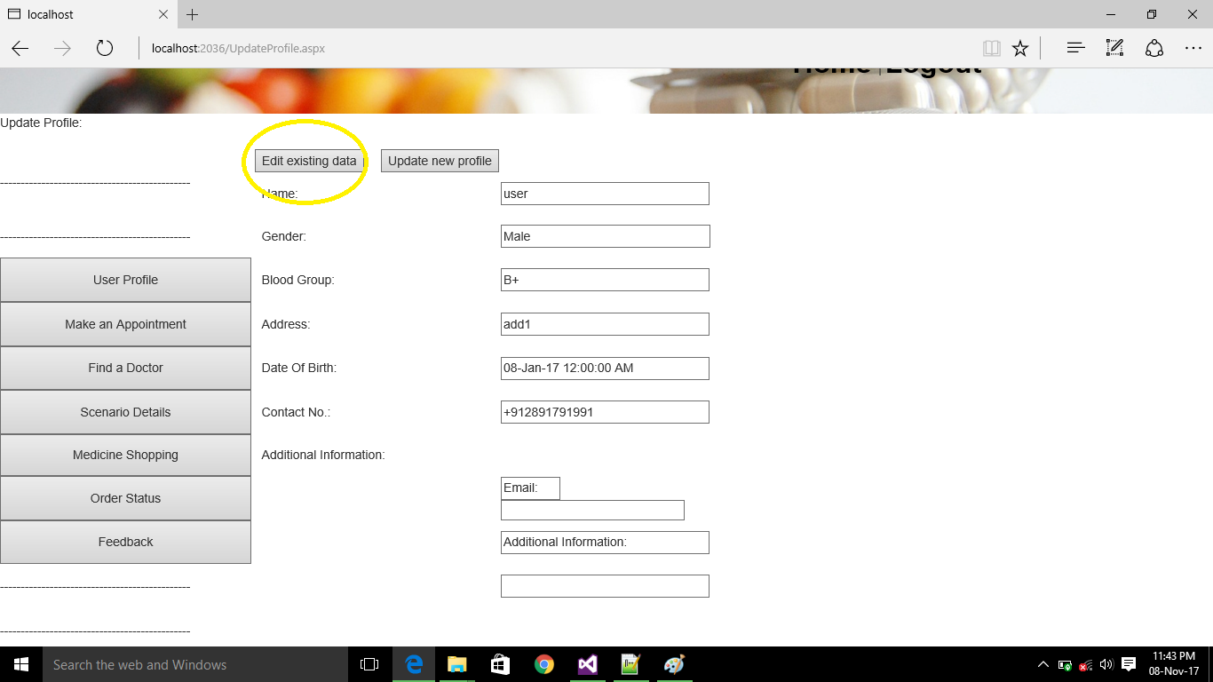

Slide 25
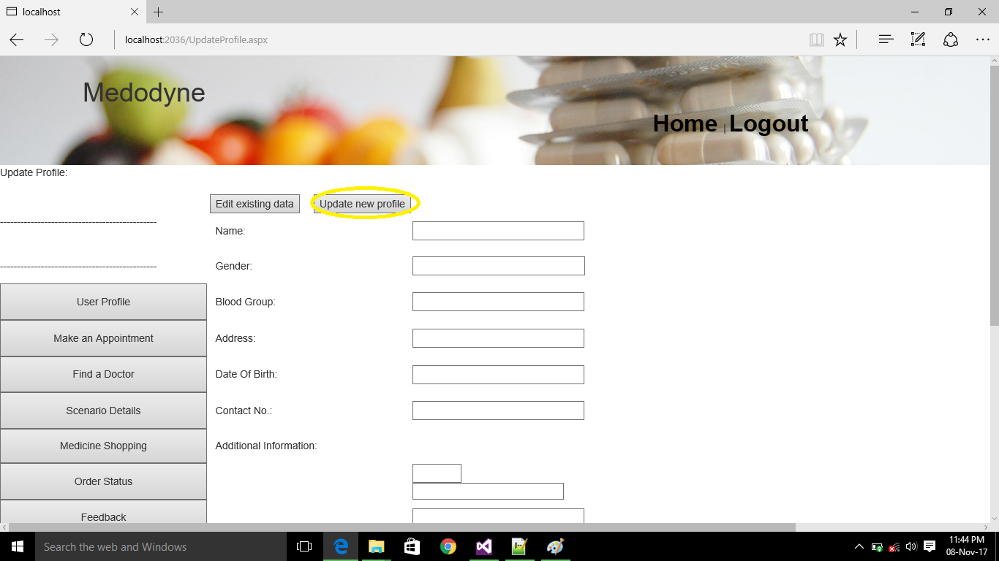

Slide 26
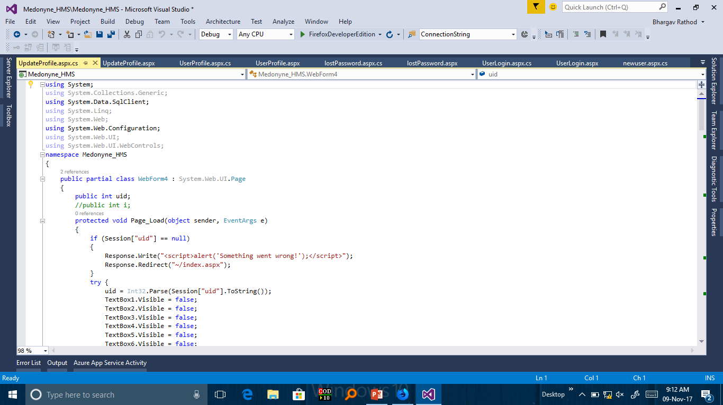

Slide 27
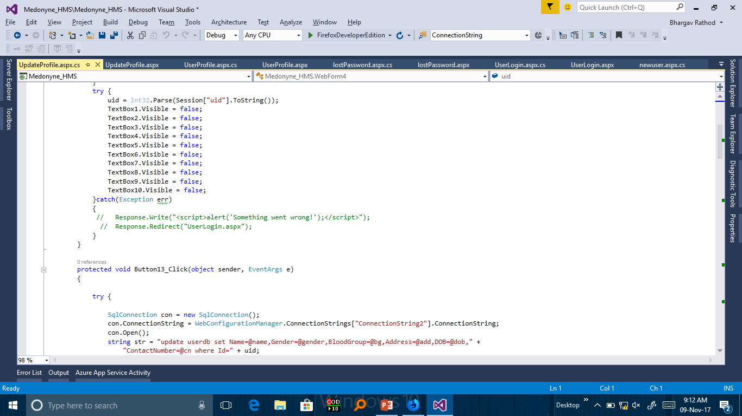

Slide 28
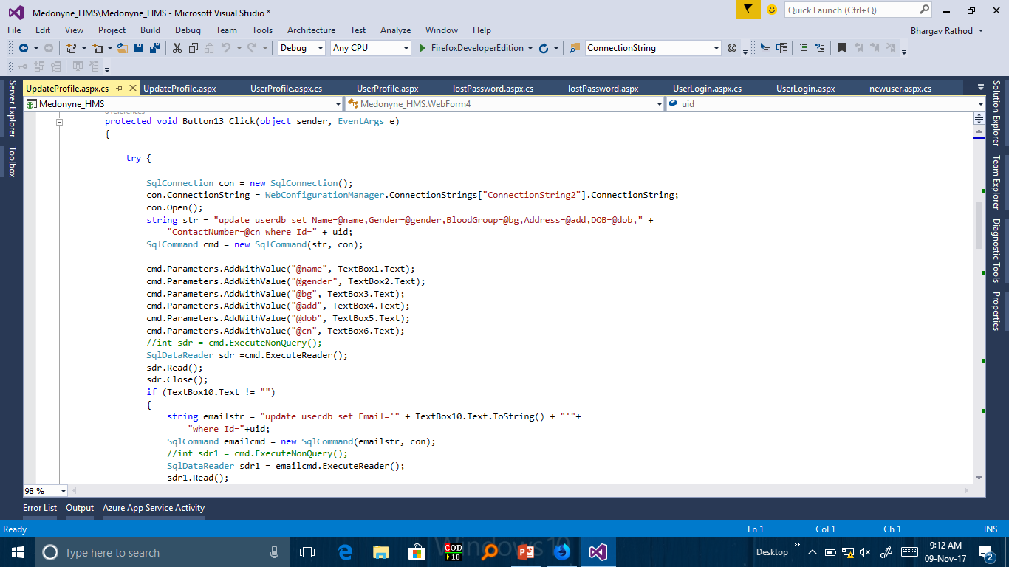

Slide 29
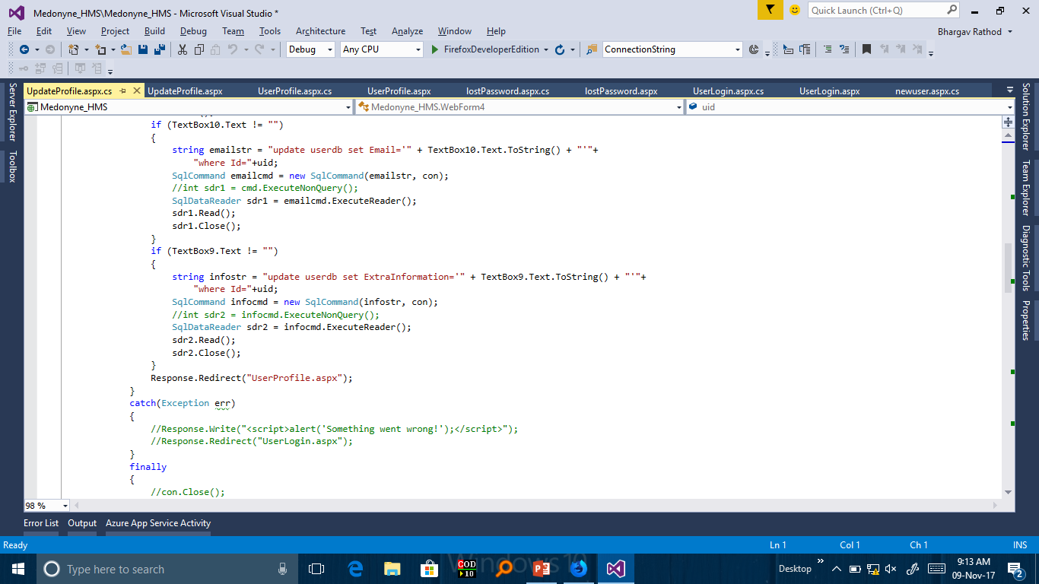

Slide 30
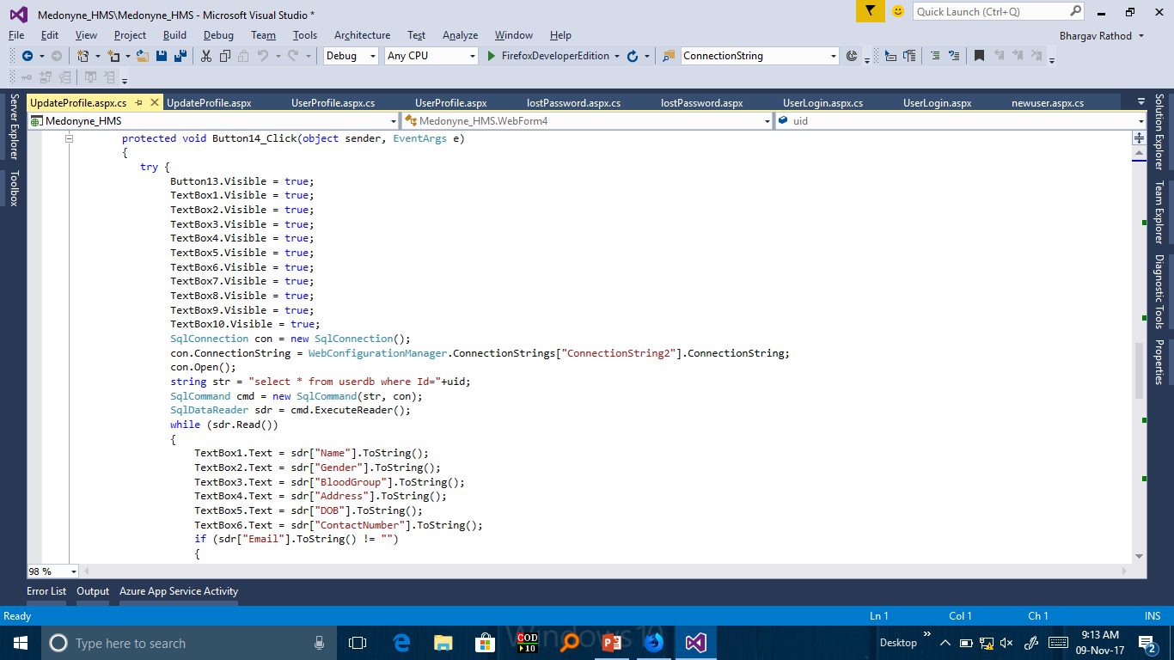

Slide 31
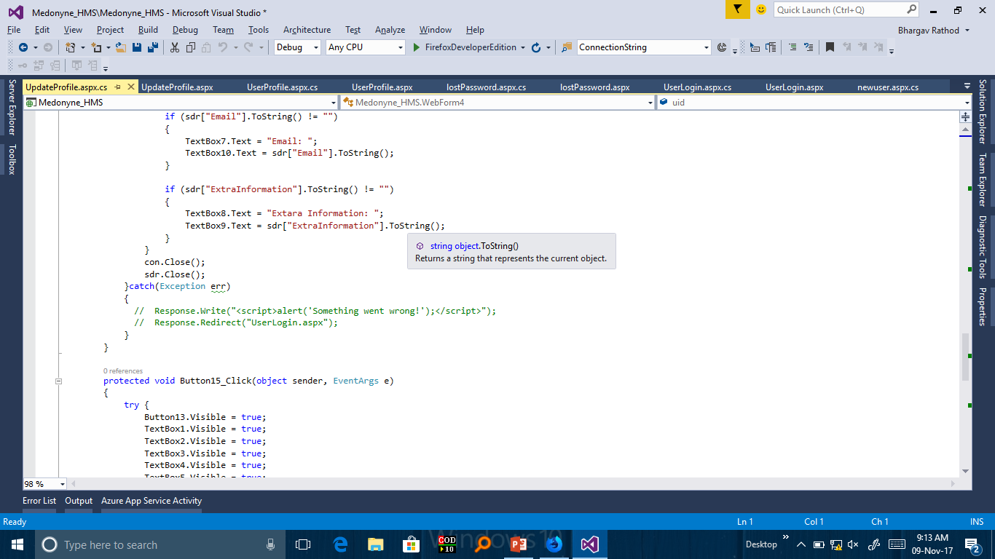

Slide 32
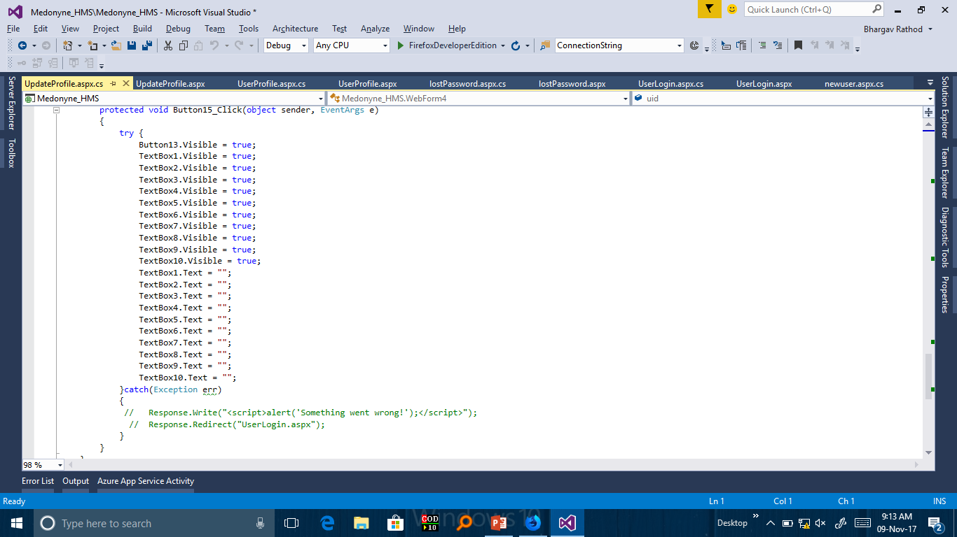

Slide 33
5. Site1.master → Master Page After Login
6. UserProfile.aspx →First Page After Login to see UserProfile
7. UpdateProfile.aspx →To update existing data about user or to update whole data
additional data like Email also can be added.

Slide 34
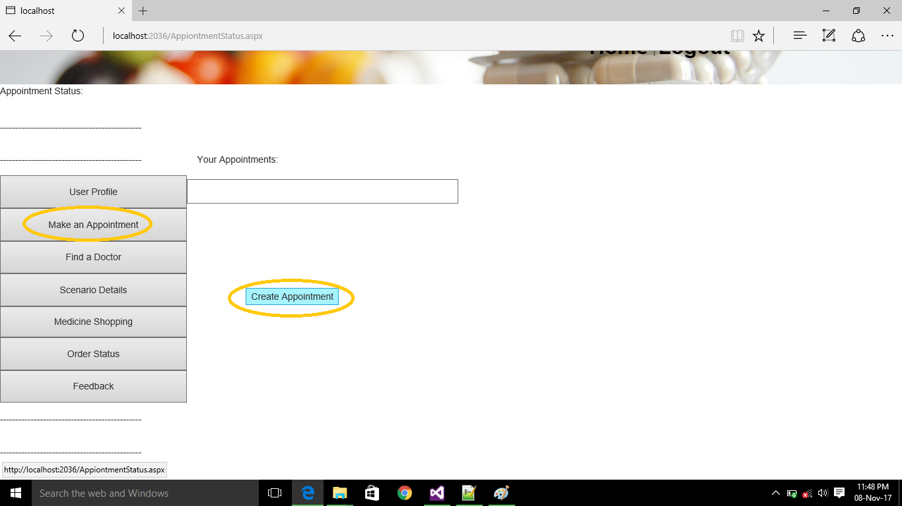

Slide 35
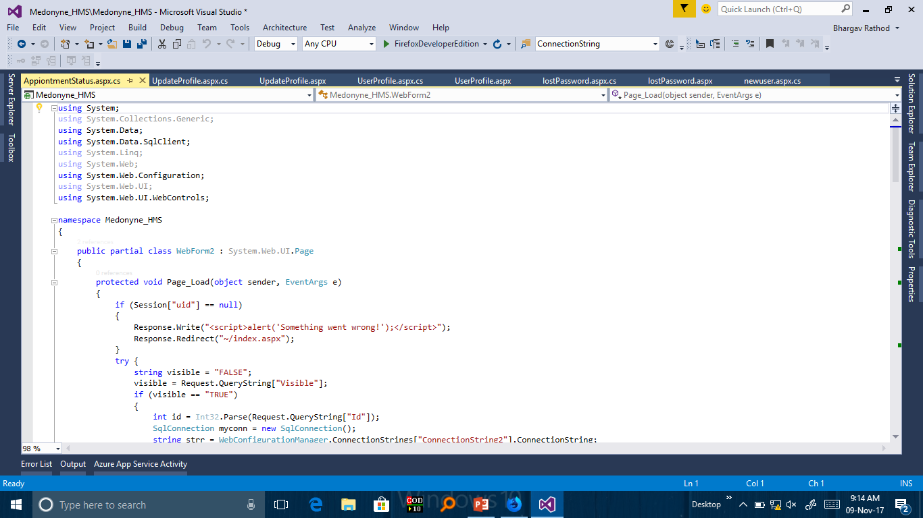

Slide 36
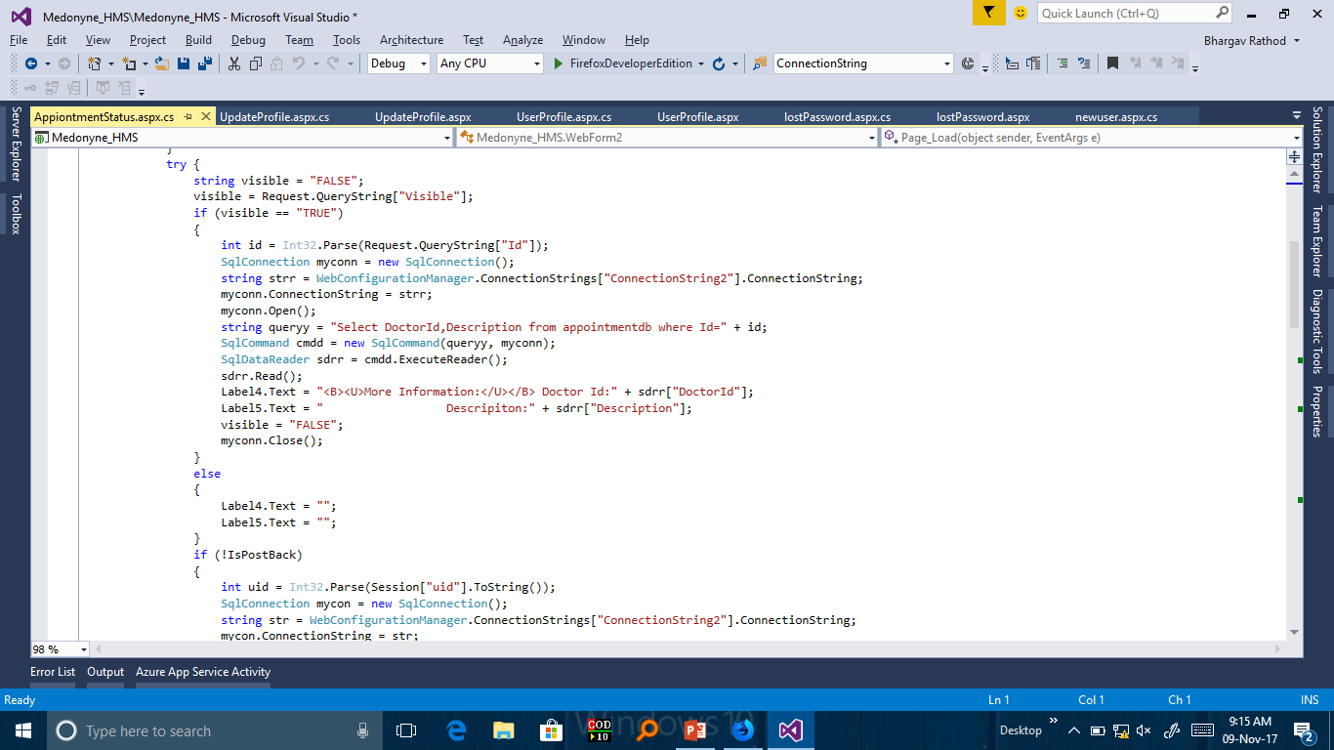

Slide 37
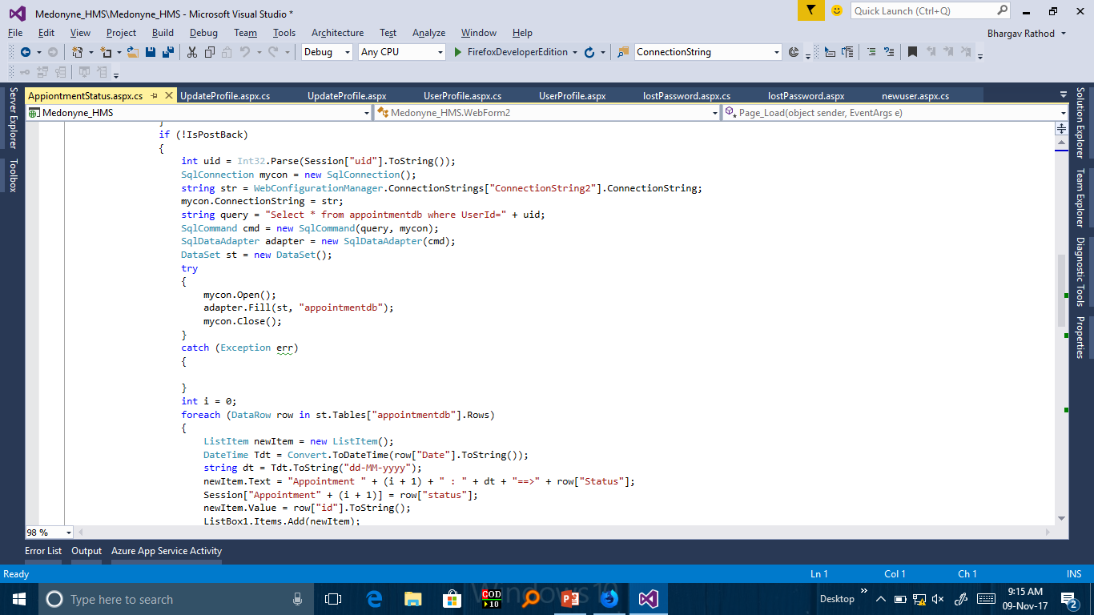

Slide 38
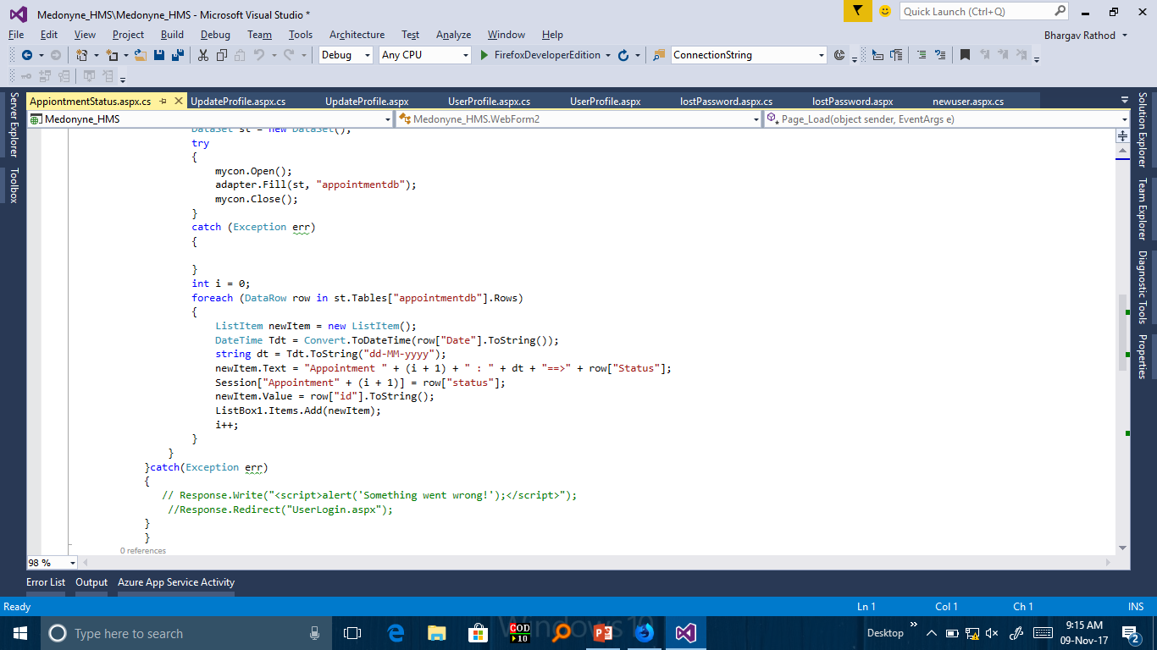

Slide 39
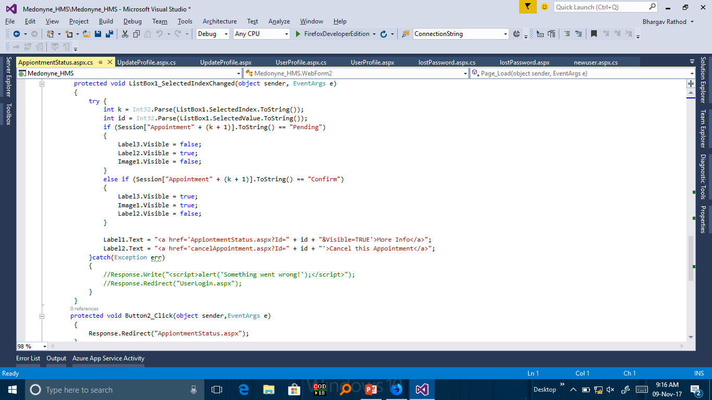

Slide 40
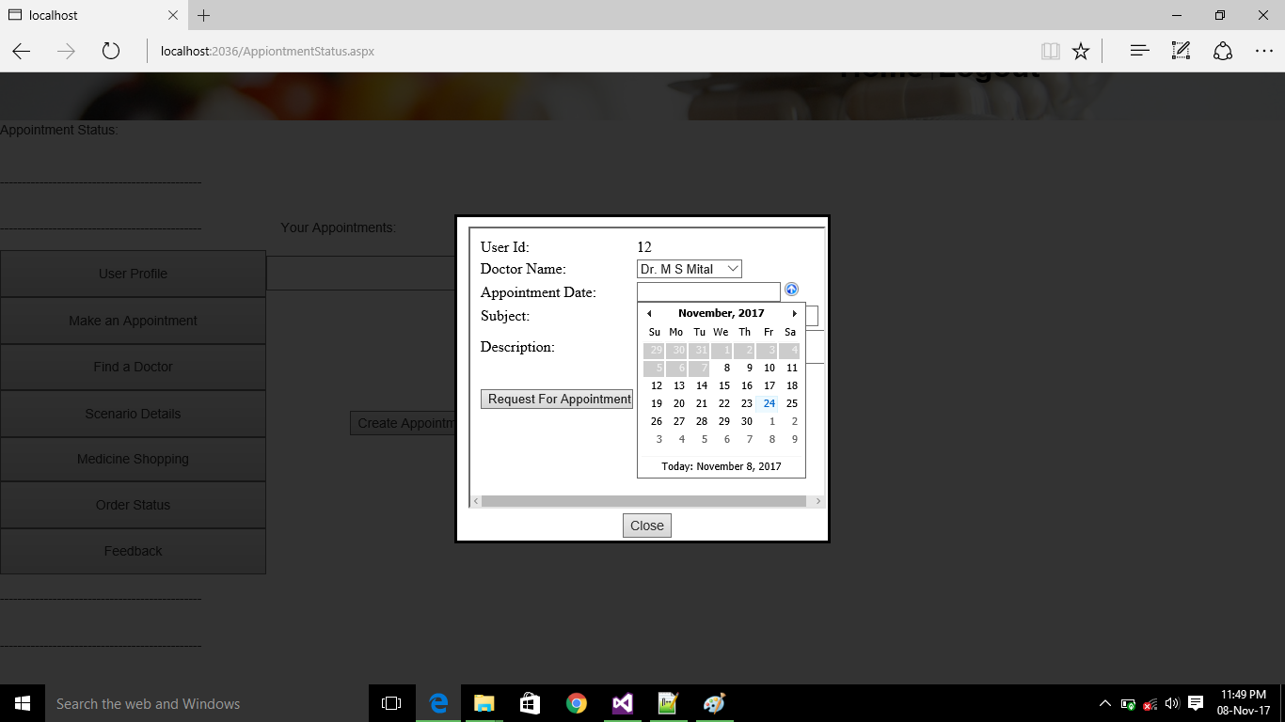

Slide 41
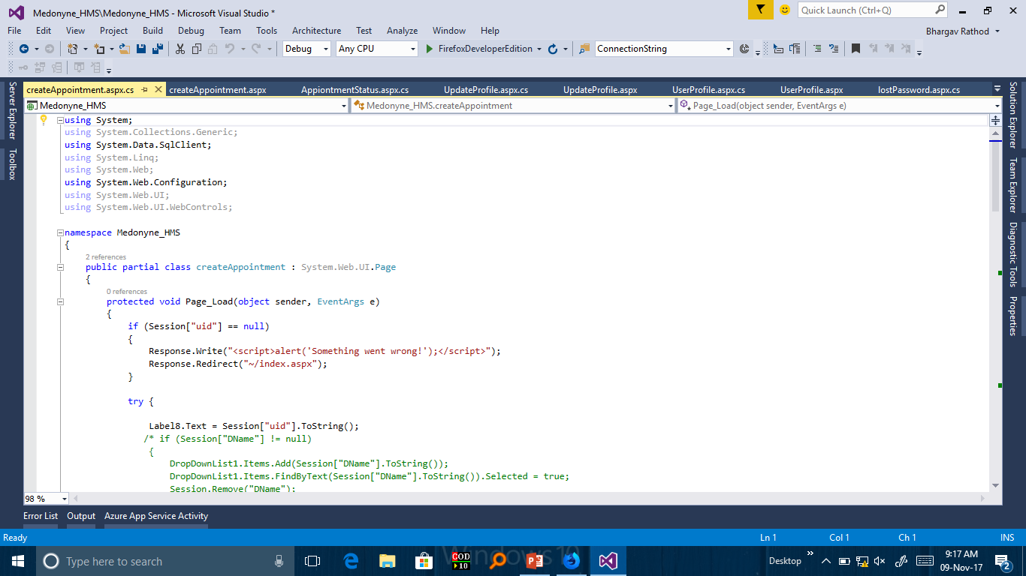

Slide 42
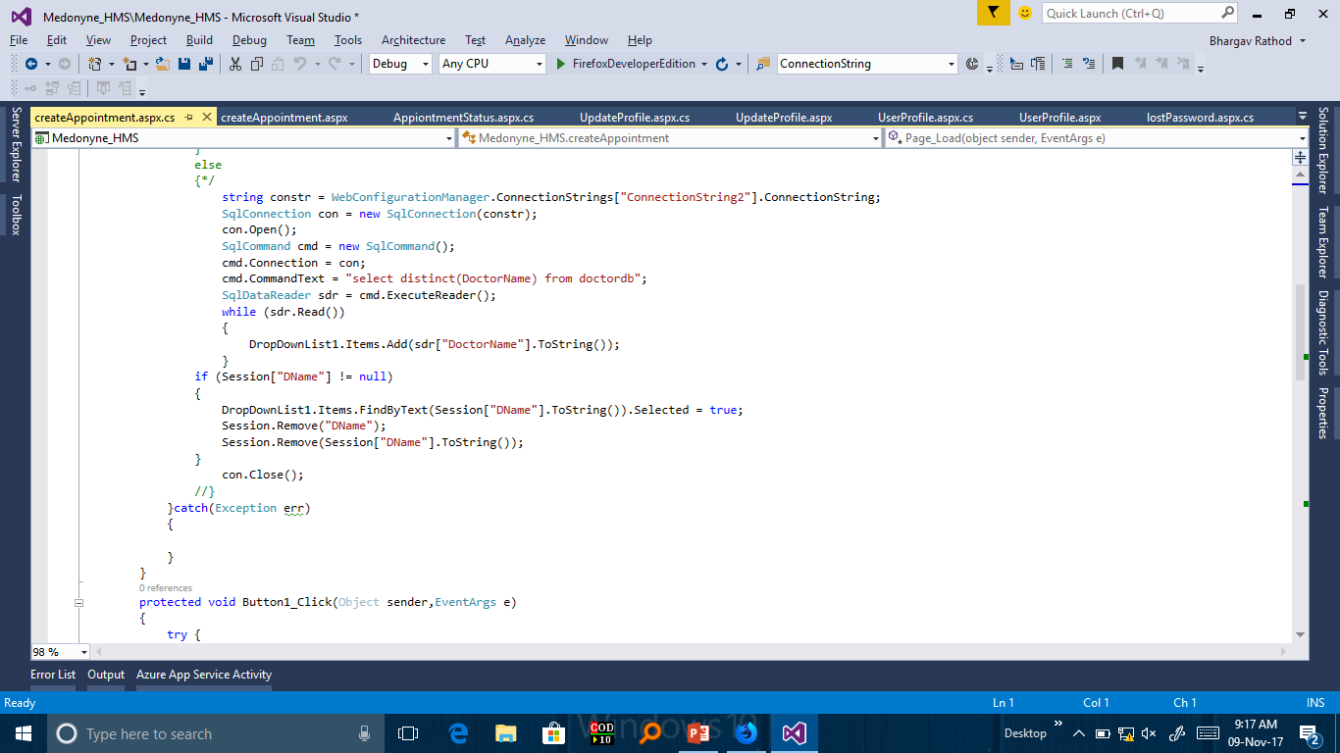

Slide 43
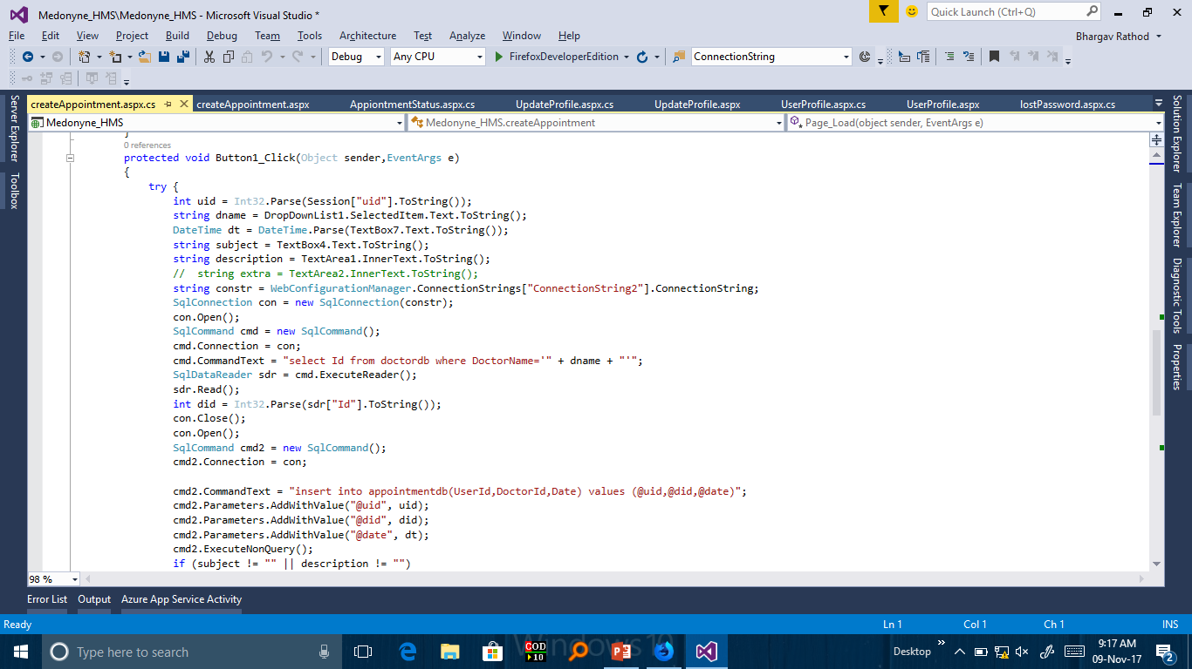

Slide 44
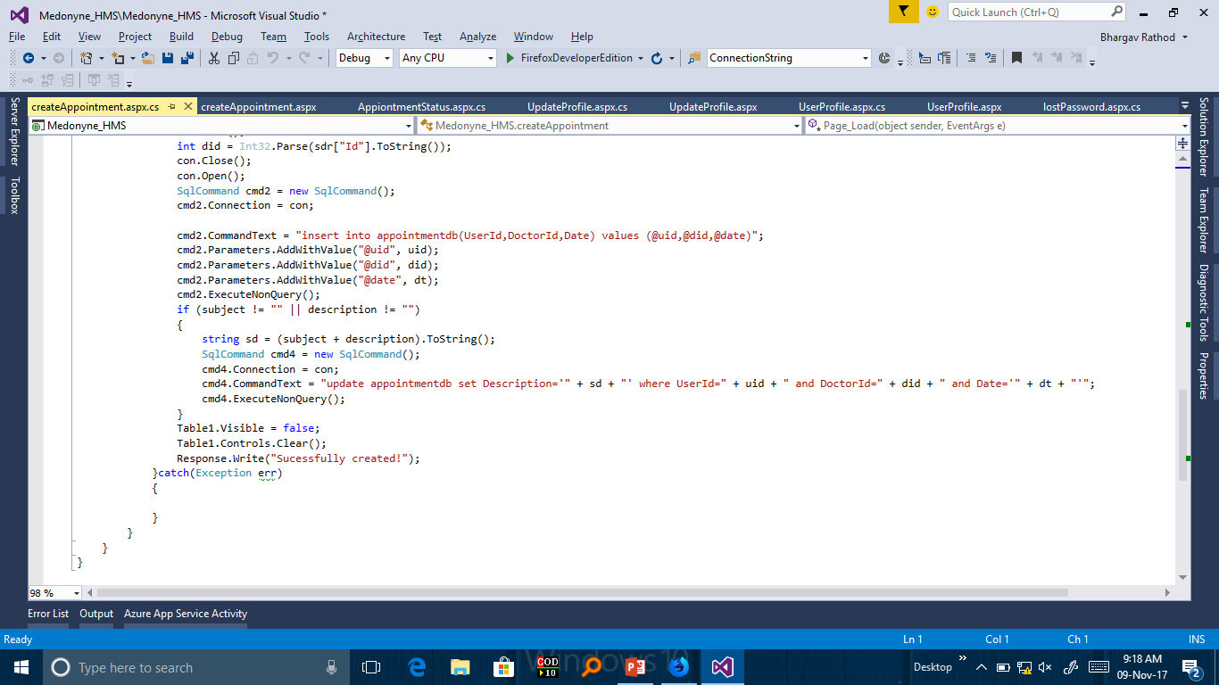

Slide 45
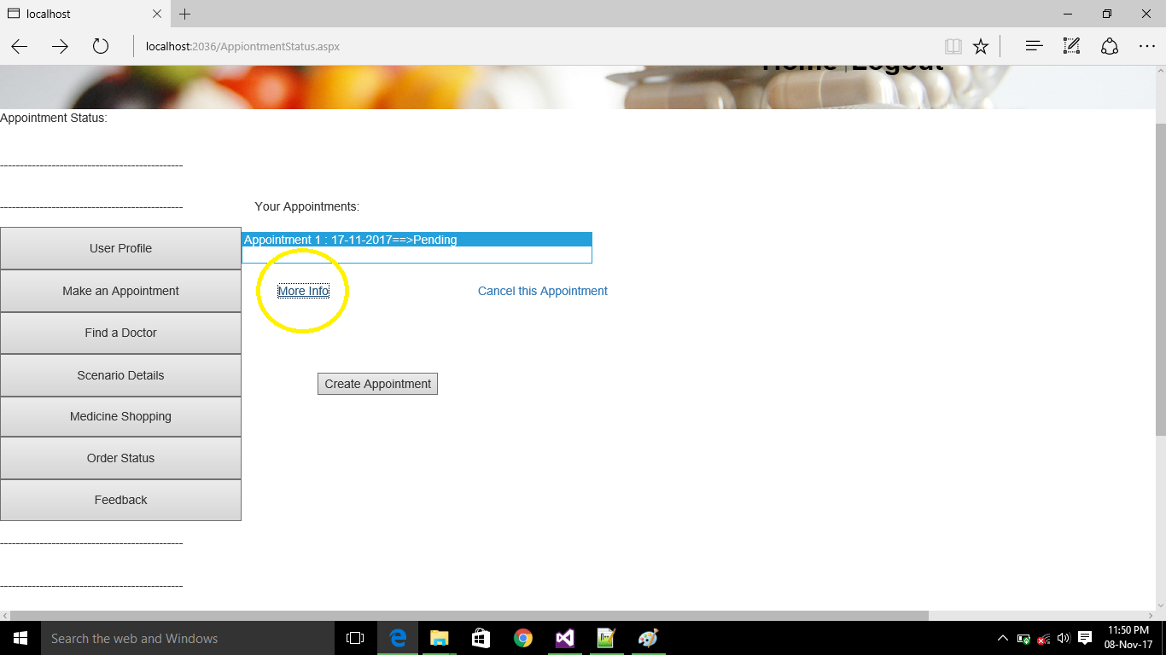
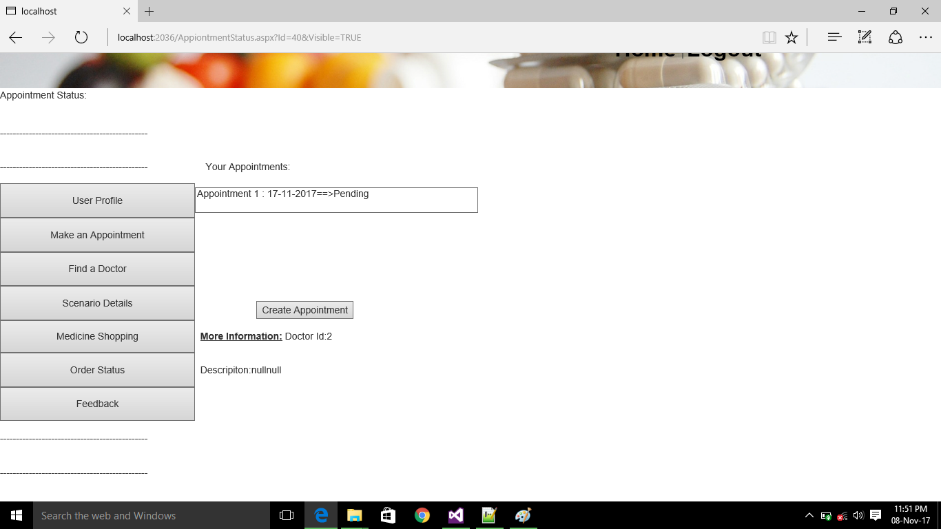

Slide 46
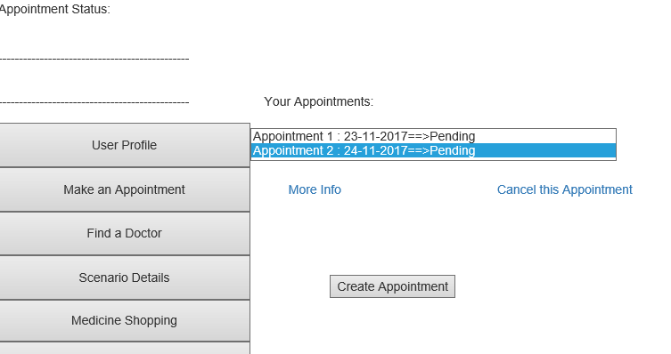

Slide 47
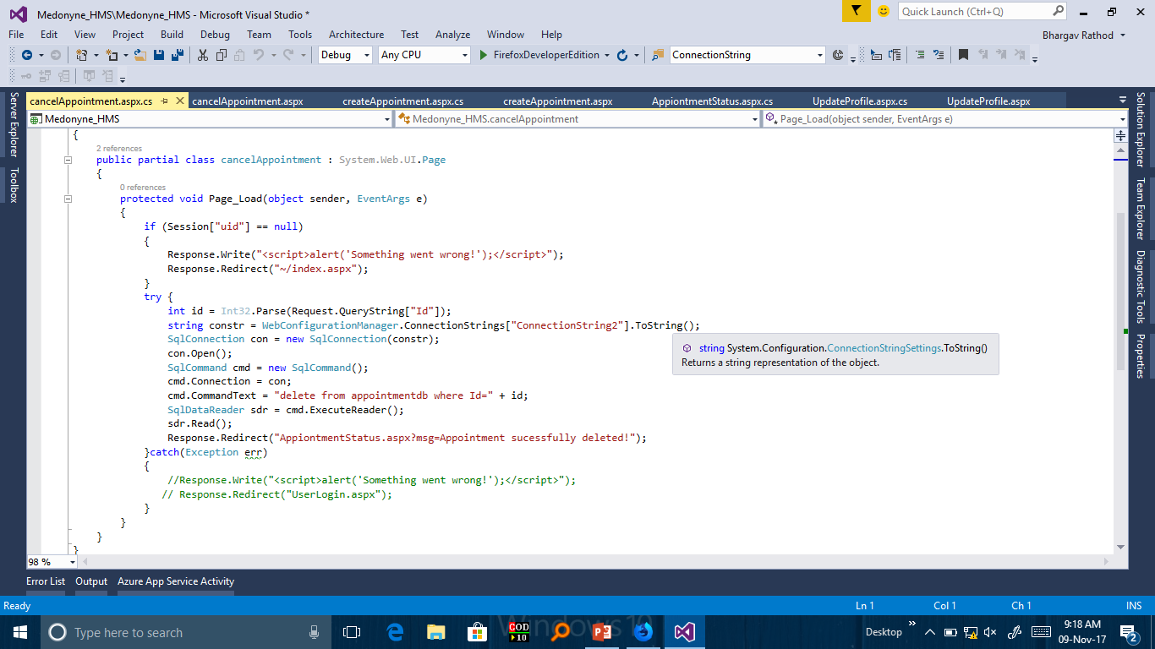

Slide 48
8.AppointmentStatus.aspx → For Viewing Information about Selected Appointment
9. CreateAppointMent .aspx →For creating an appointment
10.CancelAppointment.aspx →To Cancel an appointment if not confirmed or cancelled by user

Slide 49
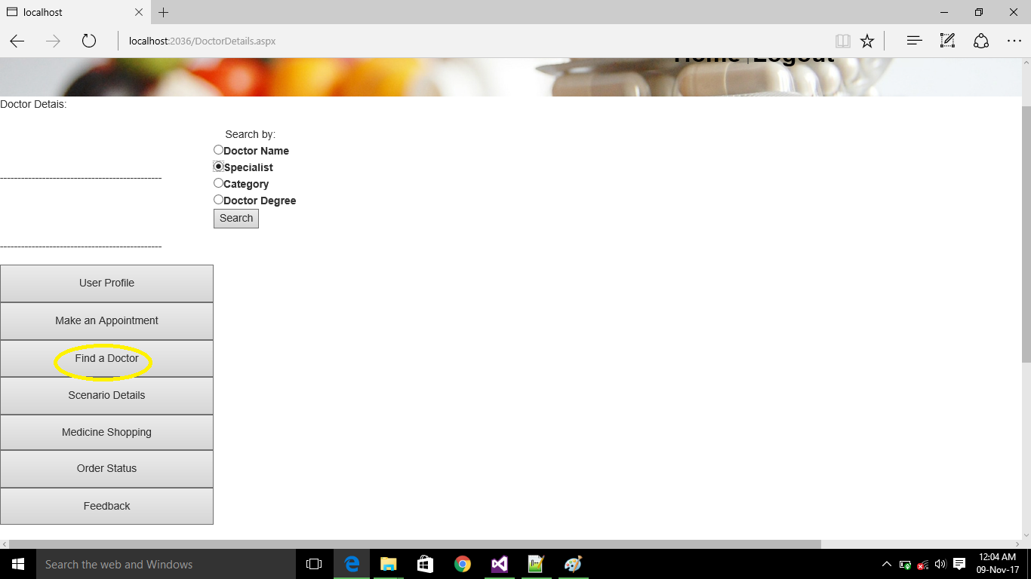

Slide 50
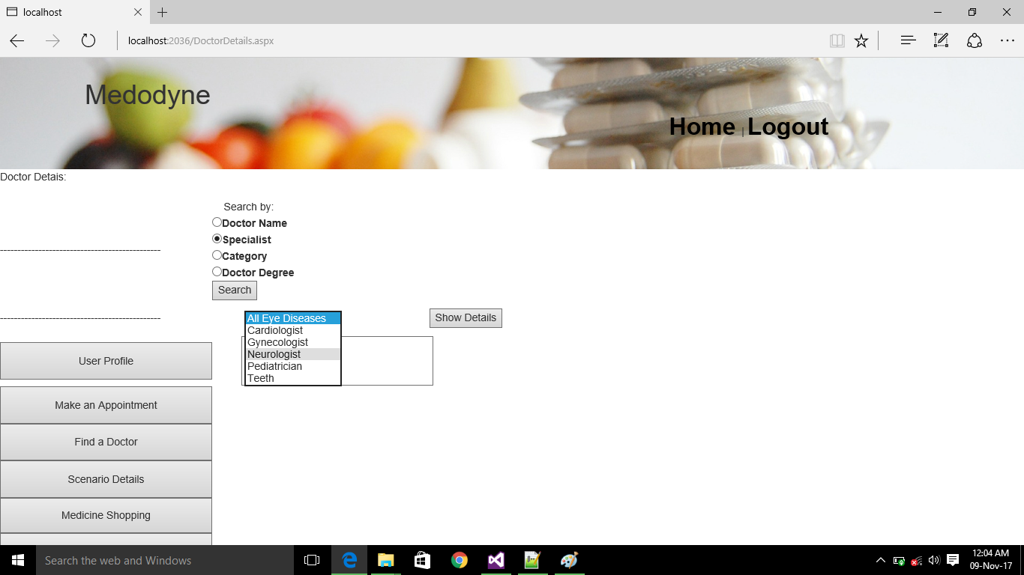

Slide 51
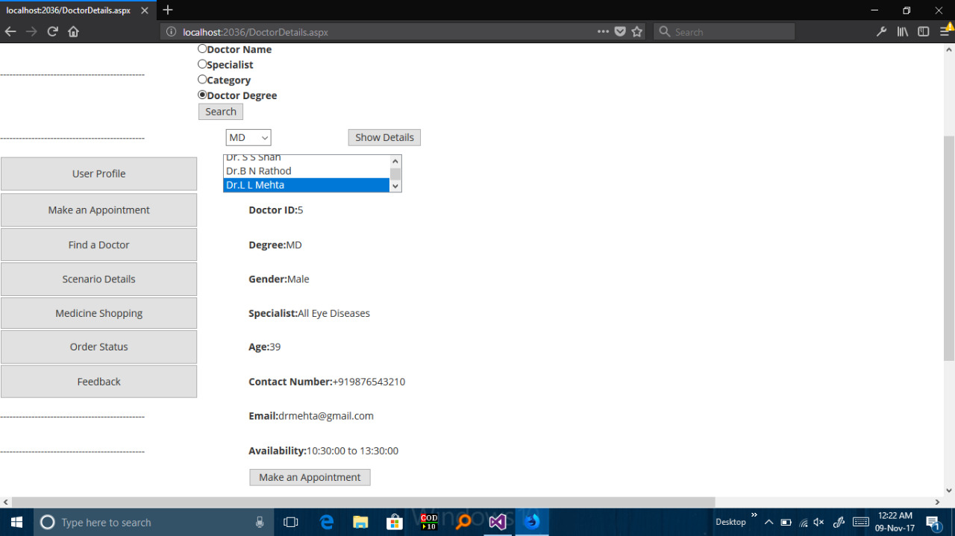

Slide 52
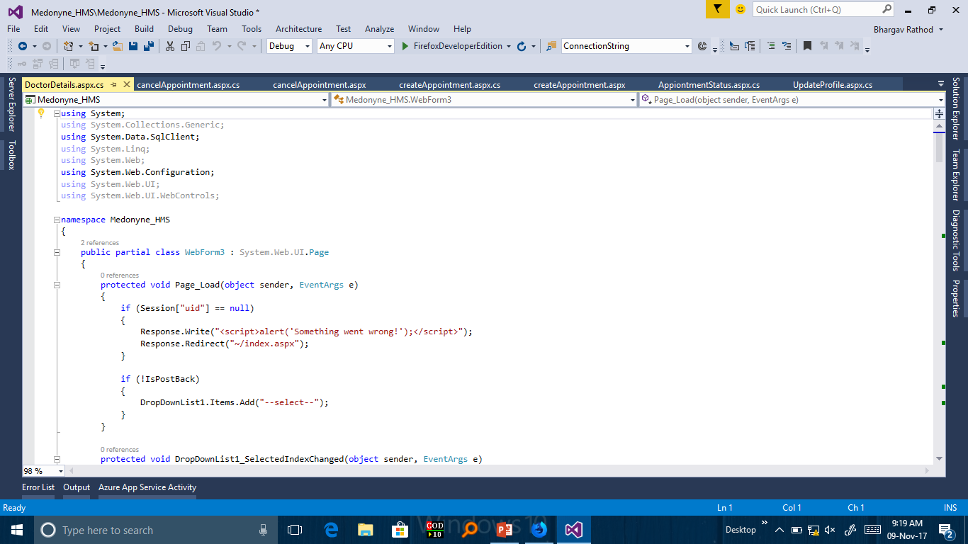

Slide 53


Slide 54


Slide 55


Slide 56


Slide 57


Slide 58


Slide 59


Slide 60
11. Doctor Details.aspx → To find Doctor By name , specialist , category or degree.
If any Option other than name is selected for search then
ListBox will be Visible after Selecting ListItem We can show
Details about Selected Item(DoctorName).
Directly Appointment Also can be created with searched Doctor.

Slide 61


Slide 62

12. RoomDetails.aspx→RoomDetails can be seen by room no and current room status also can be seen

Slide 63


Slide 64


Slide 65


Slide 66


Slide 67


Slide 68


Slide 69


Slide 70


Slide 71


Slide 72


Slide 73


Slide 74


Slide 75


Slide 76


Slide 77


Slide 78


Slide 79


Slide 80


Slide 81


Slide 82
13.MedicineShopping.aspx →To shop medicine by search or by selecting from data table and to add choice in cart
14. UserCart.aspx → See Data from cart

Slide 83


Slide 84

15.Feedback.aspx →To give feedback

Slide 85


Slide 86


Slide 87


Slide 88


Slide 89
Admin Functionalities
In Admin Panel There is options provided for User Details that is for see user details of user database or to remove or edit details of user database
Appointment request is for see appointments and status and also for cancel or confirm appointment
Update medicine shop and orders for adding or removing medicine from medicine database and to view or change order details.
Update doctors is for add , remove doctor or to view info. About doctor.
And feedback status also can be seen and deleted.

Slide 90

16.AdminLogin.aspx →To login Admin

Slide 91

17.AdminPage.aspx →To choose option from admin functionality

Slide 92

18.UserDetail.aspx

Slide 93

19.AppointmentRequest.aspx

Slide 94

20.UpdateMedicine and order.aspx

Slide 95


Slide 96

21.RemoveMedicine.aspx

Slide 97

22.OrderDetails.aspx

Slide 98

23.FindDoctors.aspx

Slide 99


Slide 100


Slide 101

Schema Diagram

Slide 102


Slide 103


Slide 104


Slide 105


Slide 106


Slide 107


Slide 108


Slide 109


Slide 110


Slide 111


Slide 112


Slide 113
Thank you!!!

